Slide 1

M-ADSheild
Attack Automatic Analysis and Interception Engine in Mobile App
Notes:
感谢大家来观看我们的产品
Thanks everyone for watching our products
今天我为大家介绍的产品是M ADSheild，一款移动应用中的攻击自动分析拦截引擎.
Today.I will introduce our security product – M ADSheild . An attack automatic analysis and interception engine in mobile application .
在接下来，我会介绍 M ADSheild 的背景、思考、和实现的方法，如果有任何问题，大家可以随时打断我
In the following, I will introduce the background, thinking, and implementation of M ADSheild. If you have any questions, you can interrupt me at any time.

Slide 2

M-ADSheild
Attack Automatic Analysis and Interception Engine in Mobile App
Author:
Cao Shijie / Zhao Hao
Work at Kunlun Security Laboratory in Ant Financial, responsible for the basic security of the Ant Financial and the construction of automatic vulnerability testing, have identified hundreds of security vulnerabilities.
Contents:
Security risks in mobile application
Difficulties faced by mobile security engineer
Thinking - Personalized defense for users
Security Product – M ADSheild
Notes:
首先，请允许我自我介绍一下
First, allow me to introduce myself
我来自于蚂蚁金服昆仑安全实验室，主要负责建设公司国际移动应用产品的安全能力以及漏洞挖掘.
I am from Ant Financial Kunlun Security Lab. I am foucse on building the company's international mobile application product security ability and vulnerability testing.
我需要介绍几块内容，首先会线介绍移动应用程序面临的安全风险以及移动安全工程师面临的困难，随后介绍我们对于M-ADSheild的思考和如何设计的
I need to introduce two block of content. First, I will introduce the security risks facing mobile applications and the difficulties faced by mobile security engineers. Second I will introduce our thinking about M-ADSheild and how to design it.

Slide 3










1. Security risks in mobile application
https://evil.com/attack
In the mobile application, the hacker only needs to send a link and the user can be attacked.
Notes:
随着移动应用的功能越来越广泛，移动应用程序已经拥有如社交、支付、多媒体等多方面功能，而安全问题对用户带来的问题也越来越多
As the mobile applications become more and more popular, mobile applications have various/'veərɪəs/ ability , such as social networking, payment, and media and so on , and it also to brought more and more risk to users.
如 钱被盗刷、用户被钓鱼导致的数据泄漏等等，而常常攻击者只需要通过一个链接就可以对用户进行攻击
Such as stolen money, data leakage caused by phishing., and the attacker always only needs to send a link can attack the user.

Slide 4
2. Difficulties faced by mobile security engineer
Everywhere maybe exists
vulnerabilities
Mobile app
Phishing attack
Xss
Browser
Scheme
RPC
Logic by pass
Bridge
Logic
Different kinds of vulnerabilities.
Vulnerabilities never ending.
Native layer
Path crossing Attack
I/O
photo
Cookie
…
Notes:
随着移动应用程序的功能越来越多，移动端出现的漏洞种类也越来越丰富。
With the increasing variety of mobile applications, the variety of attack that appear on the mobile application is also increasing.
逻辑越来越复杂，使得出现漏洞的位置也越来越多，可以认为，任何代码的地方都可能存在漏洞
The logic is more and more complicated, so there are more and more places where vulnerability appear. It can be considered that there may be risk in any code.

Slide 5



3. Thinking - Personalized defense for users
How to identify attack behavior based on normal user operations.
99% Safety
1% Threat
Notes:
我们一直在思考一个问题：如何给用户设计一款个性化的防御产品
We have been thinking about a problem: how to design a personalized defense product for users
因为在正常使用过程中，用户对于应用程序99%的操作都是安全的，而恰巧只有1%的操作存在风险，如果我们能基于用户的操作习惯进行学习，并且对基础功能进行有效保护，可以针对不同的用户有定制化的防御能力。
Because during normal use, 99% of the application's operations by the user are safe, and it happens that only 1% of the operations exists risk.
If we can learn based on the user's operating habits and effectively protect the core service, can build defense capabilities for different users.

Slide 6

4. Security Product – M ADSheild
a. M-ADSheild is an active defense engine base user operation.
b. Plug-in component.
c. Pure client security products.
Notes:
M ADSheild就是这样一款产品
M ADSheild is such a product.
( M ADShiled 是一款基于用户行为的主动防御产品, 是一个插件化的产品 , 纯客户端上的安全产品 )
这意味着，对于开发者而言，不需要依赖服务端，只需要通过一定的配置，就可以将这款产品投入到应用程序中进行使用。
This means that for developers, there is no depend on the server, and only do some configuration is required to put this product into an application for use.
下面，我将介绍 M ADSheild 一些重要的设计
Next , I will introduce some important designs of M ADSheild

Slide 7





4. M ADSheild - Security aspect
In M-ADSheild, we use security aspect to achieve control over the system services.
WebKit
I/O
M-ADSheild
URL Scheme
Network
M-ADSheild
Active
3rd Party
SDK
Notes:
在M-ADSheild中，引用到安全切面的概念
In M-ADSheild, reference to the concept of security aspects
概念：Concept
安全切面，意味着在应用程序的一些关键节点进行管控，实现对调用请求的风险检测和风险拦截
Security aspects : which means control at some key nodes of the application, to implementation risk detection and risk interception of api requests
如何实现安全切面进行管控：
How to implement security aspect management and control:
M-ADSheild 会对应用程序中多个核心服务进行Hook，并将执行逻辑路由到一个决策中心，决策中心会对函数名称，参数，以及调用序列等因子进行判断，来检测当前请求是否有一定风险。
M-ADSheild will hook some of core services in the application and route the execution logic to a policy center. The policy center will judge the function name, parameters, and calling sequence and other elements to detect whether the current request has certain risks.

Slide 8
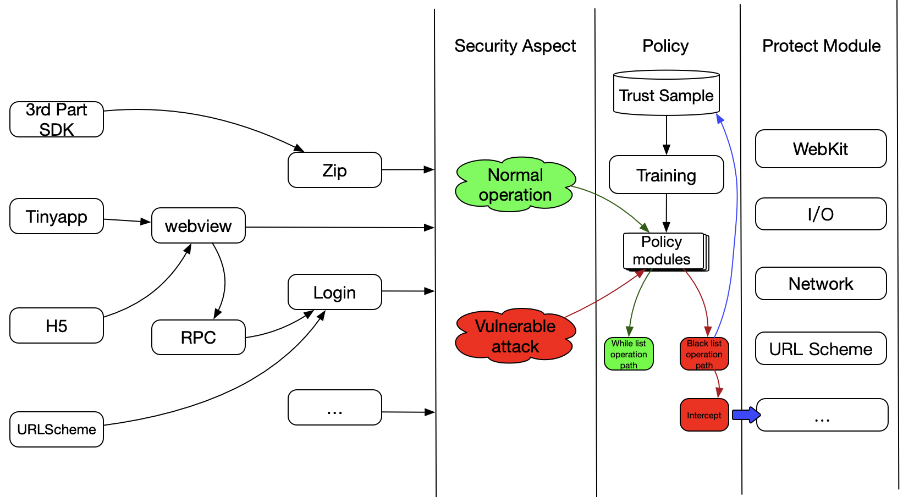
4. M ADSheild - Architecture
Notes:
如刚才所说，我们通过安全切面的方法对系统服务进行了接管，那么我们如何进行防御呢？
Like just say, we can control the core services through the security aspect, so how do we defend ?
在M-ADSheild中内置的决策中心，所有对核心能力的访问都会触发到我们决策中心的校验
The policy center in the M-ADSheild, all access to core capabilities will route to do verification of our policy center
而决策中心背后，使用到多个安全模型和算法，来对当前的调用进行分析和判断
Behind the policy center, multiple security models and algorithms are used to analyze and judge the current api requests.

Slide 9
Thread1
Thread2
Thread N
api1
api2
...
api n
param1
param1
param2
...
api1
param1
api2
param1
param2
...
...
api n
api1
param1
api2
param1
param2
...
...
api n
4. M ADSheild - Model training
Thread1
Thread3
Thread N
api1
api2
...
api n
param1
param1
param2
...
Api 5
param1
Api1
param1
param2
...
...
api n
api1
param1
api2
param1
param2
...
...
api n
How can we identify the risk of the operation ?
Notes:
1. 现在我们拥有了对应用程序核心服务的管控能力，现在的问题是，我们如何对不安全的操作进行识别？
Now that we have the ability to control the core services of the application, the question is, how do we identify risk operations?
2. 基于经验，我们可以这样认为：漏洞攻击所产生的调用链，是不同于正常用户的操作的，比如参数、调用序列
Based on experience, we can think that the api sequences generated by the vulnerability attack is different from the operation of normal users, such as parameters and call sequences.
所以，我们将多种模型以组件的形式接入到决策中心，接下来我会介绍我们实验比较成功的2种模型：
Therefore, we will access a variety of models to the policy center. Next, I will introduce two of userful models :
3. 我们选择了贝叶斯模型来训练正常的调用序列，当用户正常的操作时，M-ADShiled会基于当前的运行时 不同的线程、堆栈、以及参数 来生成可信的向量.
We chose the Bayesian model to train normal api call sequences. When the user operates normally, M-ADShiled will generate a trusted vector based on different threads, stacks, and parameters of the current runtime.
4. 而当用户触发了风险的调用时，M-ADSheild 对当前api调用序列 通过 贝叶斯网络模型计算出的向量概率会远低与可信的向量，从而标记出风险
When the user triggers a risk api call sequences, the vector probability calculated by the Bayesian network model will be much lower than trusted vector , and let M-ADSheild to recognize the api requests exists risk.

Slide 10
4. M ADSheild - Model training
How can we identify an attack payload?
Normal parameters: /var/mobile/Containers/Data/Application/F9418815-51A9-4A0A-A76C-6FD37C400928/Documents/tmp/1.jpg
open(filepath,op_type)
Attack parameters: /var/mobile/Containers/Data/Application/F9418815-51A9-4A0A-A76C-6FD37C400928/Documents/../../Library/a.info
We abstract content by character type:
1. Special characters (/ , . < > …): S
2. Letters (a - z, A - Z): M
3. Operators ( + - * / …): C
4. Numbers (0-9): N
Normal parameters: SMMMSMMMMMMSMMMM…SMNNNNNNNS…SMMMSNSMM
Attack parameters: SMMMSMMMMMMSMMMM…SMNNNNNNNS…SSSSSMMMMM…
P(normal) = p(s) * p(m) 3 * p(s) … * p(s) * p(m)2
P(attack) = p(s) * p(m) 3 * … p(s)5 * p(m)5
P(normal) > p(attack)
Notes:
此外，我们还使用了隐性马尔可夫链来对当前参数进行计算
Besides , we also use a HMM model to calculate the current parameters
由于攻击的载荷往往相对于普通的参数只有微小的区分，所以我们需要将这样的异常放大
Since the payload of the attack is often only less different from the parameters, we need to amplify[放大 /'æmplɪfaɪ/] such exception.
我们将每一个字符转换成一种状态，比如特殊字符为一类，字母为一类，从而计算每个字符对应的状态在整个参数中出现的概率，当比较小的差异通过状态转换的方式被放大之后，会导致对整个参数出现的概率计算结果降低，从而可以有效的使我们将异常参数得以标记。
We convert each character into a state, such as a special character as a 'S' state , and a character as a 'M' state
And to calculate the probability that the state of each character appears in the parameter.
When the less difference is amplified by the state transition after that, the calculation result of the probability will be lower, which can enable us to mark the risk parameters.
当然，我们还有其他模型也会在此次开源的过程中公布，同时M ADSheild也是一个平台，任何开发者都可以上传自己开发的模型，以后大家可以一起来开发维护这款产品。
Of course, we also have other models that will be realse during the open source. At the same time, M ADSheild is also a platform. Any developer can upload their own models, and everyone can develop this product together.

Slide 11
4. M ADSheild - Usage
Enter the directory , compile with clang, and generate the dynamic library file .
(2) In the project, use dlopen to load .
(3) Developers can use the ”status” parameter to control the current running state .
(4) We have defined a variety of interception thresholds. Developers can optimize and adjust interception indicators according to the app complexity.
ADMOD_STRICT | A strict interception mode, where false alarming may occur
ADMOD_NORMAL | A general prevention and control mode, with an acceptable miss rate and false alarming rate
ADMOD_LOOSE | A loose mode, where the miss rate may rise
Notes:
接下来，就是M ADSheild的使用方法了
Next, how to use M ADSheild
除了编译以外，需要注意的是，我们2个重要的参数
Except how to build this product , we need take attention of 2 param .
Status：是定义当前是训练模式还是防御模式
Status: To define the current training mode or defense mode
另外我们定义了三种不同模式来调整不同的防御等级，从宽松到严格，需要开发者自己训练和根据自己程序的复杂度来测试
In addition, we have defined three different modes to adjust different defense levels. From loose to strict, developers need to train and test which level is suitable of their programs.

Slide 12
4. M ADSheild - Performance
We will release M-ADSheild as an open source program to make it a pluggable mobile security framework.
We will continue to provide more secure logic and model plug-ins to enrich the security defense capability of M-ADSheild.
Vulnerability types covered | Reflected XSS, cross-domain WebView, phishing, partial logic vulnerabilities, and directory traversal
System modules covered | I/O operations, WebView access, and network communication modules
Package size | ARM64 140K
Attack detection rate | 75%-80%
Models involved | 1. Similarity model 2. Markov chain model 3. Bayesian model 4. Attack vector match model
GitHub: https://github.com/SecurityLife/Mobile-ADShield/wiki/Mobile-ADShield
Notes:
最后，经过我们验证，目前M ADSheild 可以防御5种不同种类的漏洞，后面我们能覆盖更多风险
Finally, after our verification, currently M ADSheild can defend 5 different kinds of vulnerabilities, and we can cover more risks later
我们目前安全切面管控的对象包括 读写操作，浏览器访问，网络通讯 模块
Our current security aspect management objects include read and write operations, webkit access, network communication modules
整体的包大小是单架构140K，目前的检出率经过测试大概是75%-80%
单个体系结构的包装大小为140KB，测试后当前的检测率约为75％-80％
目前我们提供4种不同的模型包括，后面可能会有更多的模型公布
Currently we provide 4 different models including, more models may be realse later
大家可以记录我们Github地址，会议结束后，我们会上传我们的源代码进行分享
You can record our Github address. After the meeting, we will upload our source code for sharing
接下来大家可以欣赏我们的demo show，直观的了解整个软件的效果
Next, you can enjoy our demo show, understand the effect of the software

